Slide 1
SBC Member Meeting
11/13/2015

Slide 2
Introduction
Please fill out and put on your name tag
Introduce yourself
Name
School
Two things you like to do in your down time

Slide 3
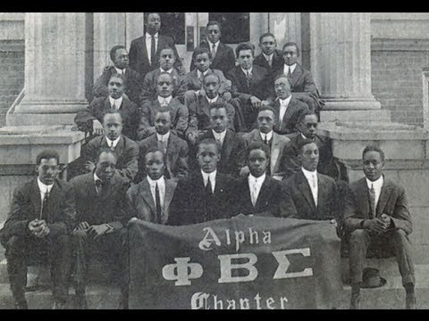
Phi Beta sigma history

Slide 4
Sigma beta club history
Affiliation: Youth Auxiliary Phi Beta Sigma Fraternity, Inc.
Founder: Dr. Parlette L. More, 20th International President of Phi Beta Sigma Fraternity
Established: 1950
Motto: Next Generation of Leaders Accepting Responsibility and Loving the Challenge
Members: Young men ages 8 to 18 In the early 1950s, Phi Beta Sigma Fraternity became the first Greek organization to develop a youth auxiliary group. Under the direction of Dr. Parlett L. More the Sigma Beta Club was founded.

Slide 5
Sbc toastmasters

Slide 6
What is toastmasters?
Toastmasters International is a non-profit educational organization that teaches public speaking and leadership skills through a worldwide network of clubs.

Slide 7
Why are you joining the sbc toastmasters course?
To empower YOU to develop communication and leadership skills, resulting in greater self-confidence and personal growth.

Slide 8
Breakout session
Form into groups of 3 (will depend on the number of people)

Slide 9
Activity
Tell a story. It can be fictional, non-fictional, sci-fi, biographical, auto-biographical, etc
This will be recorded for future playback (to see your progression)

Slide 10
Comments/feedback

Slide 11
Assignment #1
Write one paragraph on something that you enjoy. It can be anything in the world. Memorize it as best as possible. The next meeting you will tell relay your narrative.

